Slide 1
LINQ

Slide 2
What is LINQ?
LINQ (Language Integrated Query) is uniform query syntax in C# and VB.NET to retrieve data from different sources and formats. It is integrated in C# or VB, thereby eliminating the mismatch between programming languages and databases, as well as providing a single querying interface for different types of data sources.

Slide 3
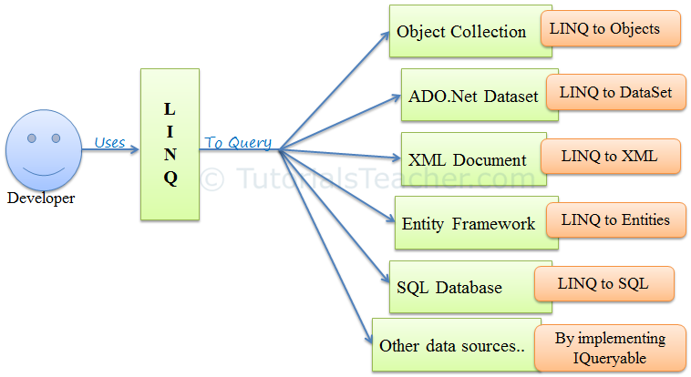

Slide 4

LINQ to SQL
LINQ to SQL is an Object –Relational Mapping(ORM) implementation that allows the direct 1-1 Mapping of Microsoft SQL server database to .Net Classes and query the resulting objects using LINQ

Slide 5
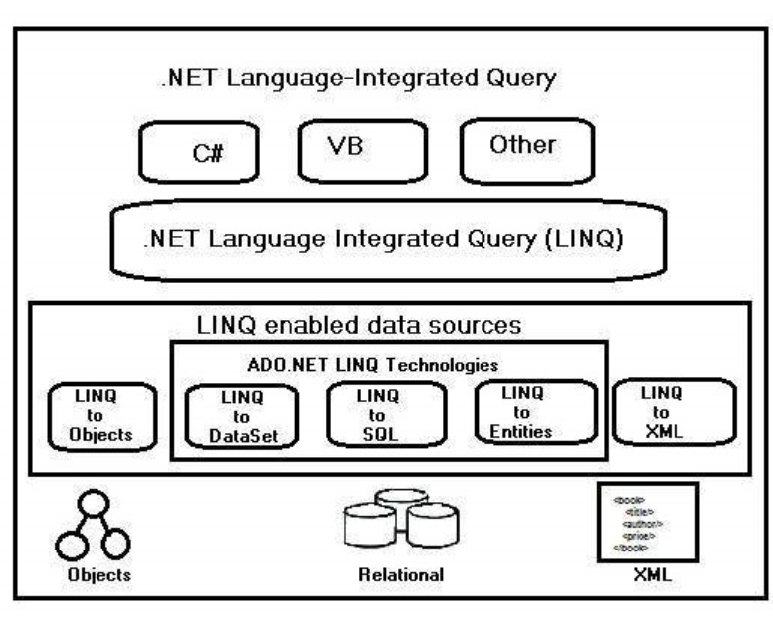
Architecture

Slide 6
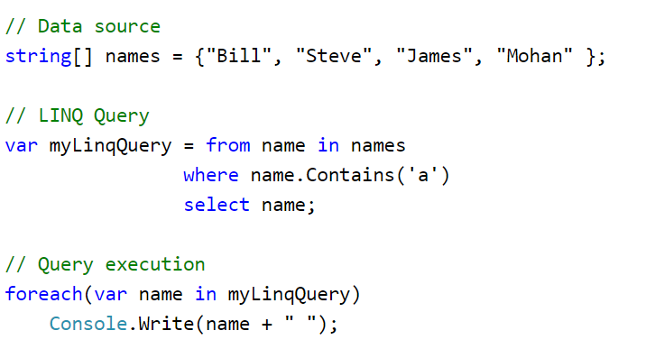
Eg 1:

Slide 7
Advantages of LINQ
Familiar language: Developers don’t have to learn a new query language for each type of data source or data format.
Less coding: It reduces the amount of code to be written as compared with a more traditional approach.
Readable code: LINQ makes the code more readable so other developers can easily understand and maintain it.
Standardized way of querying multiple data sources: The same LINQ syntax can be used to query multiple data sources.
Compile time safety of queries: It provides type checking of objects at compile time.
IntelliSense Support: LINQ provides IntelliSense for generic collections.
Shaping data: You can retrieve data in different shapes.

Slide 8
LINQ Query Syntax
1.Query Syntax or Query Expression Syntax
2.Method Syntax or Method Extension Syntax or Fluent

Slide 9
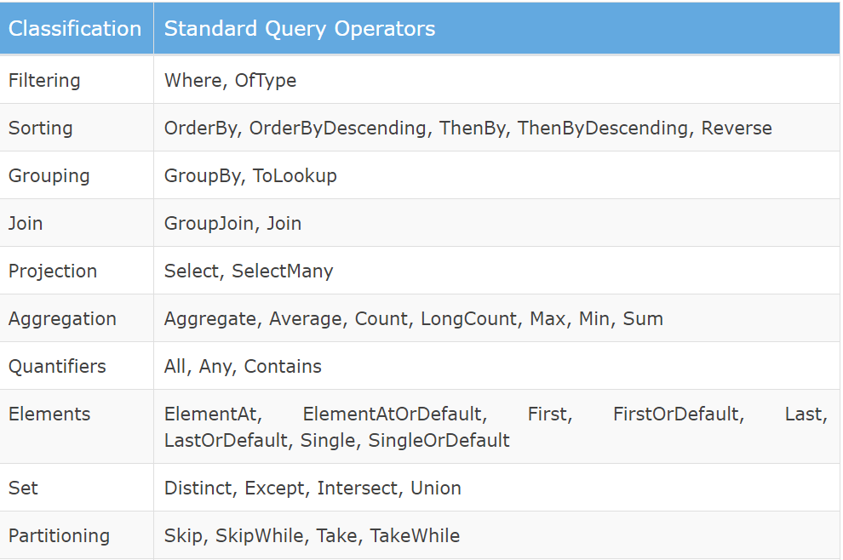
Standard Query Operators

Slide 10
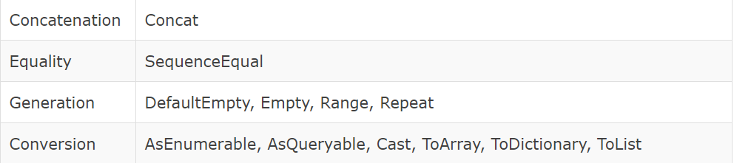
Standard Query Operators

Slide 11
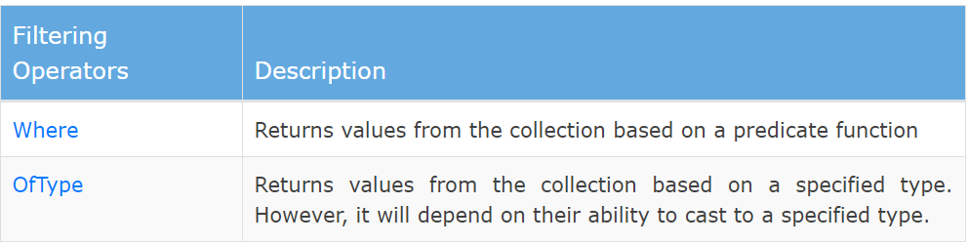
Filtering Operation

Slide 12
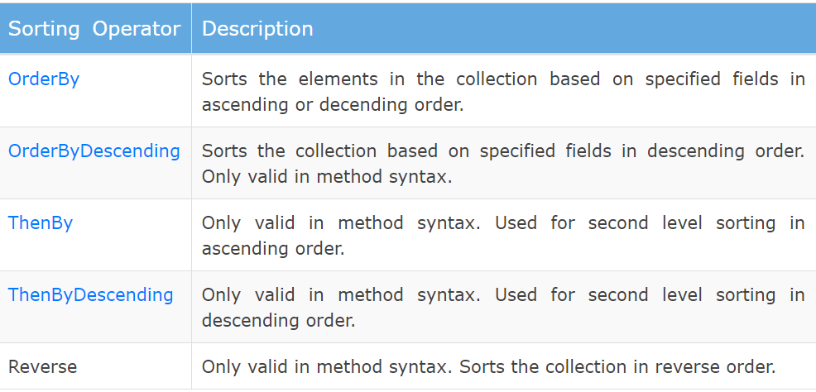
Sorting

Slide 13
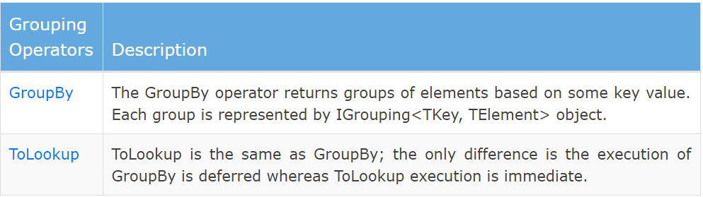
Group

Slide 14
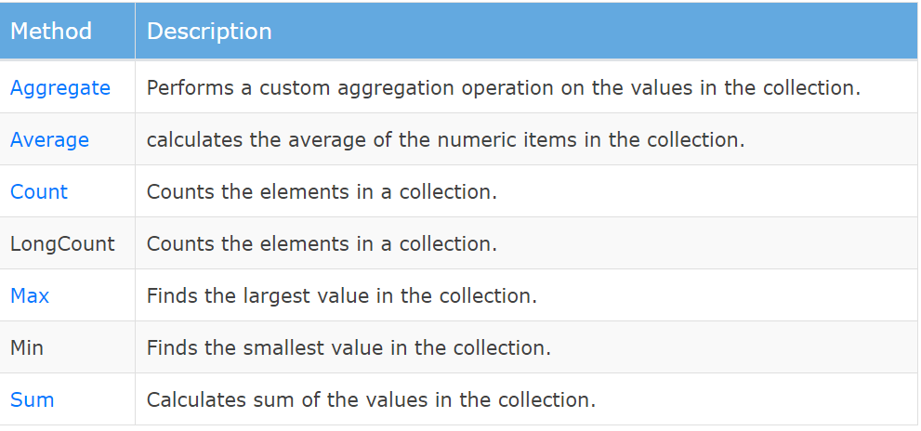
Aggregation Operators

